Slide 1
DIGITAL MUSIC STORE ANALYSIS
SQL Project By Ronit Majumdar
Portfolio links
LinkedIn:
linkedin.com/in/ronit-majumdar
GitHub:
github.com/Ronit1225
Showspace:
showspace.so/s/ronit-majumdar-eb

Slide 2
OBJECTIVE
This project is for beginners and will teach you how to analyze the music playlist database. You can examine the dataset with SQL and help the store understand its business growth by answering simple questions.
Data Set imported from https://shorturl.at/sEIUV
Total tables: 13

Slide 3
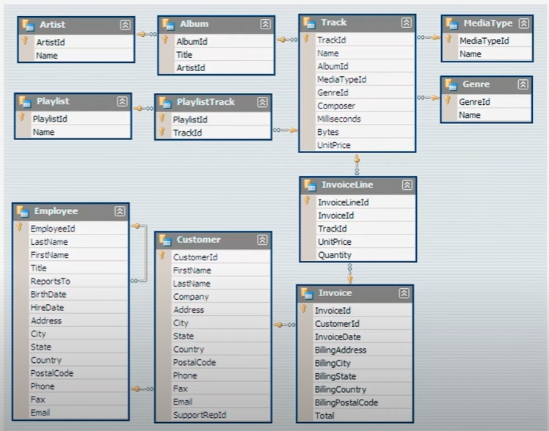
SCHEMA

Slide 4
Q1) Who is the senior most employee based on job title?
USE music_world;
select * from employee
order by levels desc
limit 1;
-- Answer: General Manager, Mr Adams Andrew
employee_id | 1
last_name | Adams
first_name | Andrew
title | General Manager
reports_to | 9
levels | L6
birthdate | 22695
hire_date | 42596
address | 11120 Jasper Ave NW
city | Edmonton
state | AB
country | Canada
postal_code | T5K 2N1
phone | +1 (780) 428-9482
fax | +1 (780) 428-3457
email | andrew@chinookcorp.com

Slide 5
Q2) Which country has the most invoices?
Invoice | billing_country
131 | USA
76 | Canada
61 | Brazil
50 | France
41 | Germany
30 | Czech Republic
29 | Portugal
28 | United Kingdom
21 | India
13 | Ireland
13 | Chile
11 | Finland
11 | Spain
10 | Poland
10 | Denmark
10 | Australia
10 | Hungary
10 | Sweden
10 | Netherlands
9 | Norway
9 | Italy
9 | Austria
7 | Belgium
5 | Argentina
select count(*) as c, billing_country
from invoice
group by billing_country
order by c desc;
-- USA has 131 Invoices, which is the most in the list.

Slide 6
Q3) What are top 3 values of Total Invoice?
select total from invoice
order by total desc
limit 3;
-- Top 3 invoices have the values 23.76, 19.8 and 19.8 respectively.
TOTAL
23.76
19.8
19.8
23.76
19.8
19.8
23.76
19.8
19.8
23.76
19.8
19.8

Slide 7
Q4) Which city has the best customers? -- We would like to throw a 'promotional Music Festival' in the city we made the most money. -- Write a query that returns one city that has the highest sum of invoice totals. -- Return both the city name & sum of all invoice totals.
select sum(total) as invoice_total , billing_city
from invoice # here sum(total) will count the total amount of invoices that came from each city and then group it together with city name then simply order it in decending to get the result.
group by billing_city
order by invoice_total desc
limit 10;
-- Top 3 cities are 273.24 Prague 170 Mountain View and 166 London
invoice_total | billing_city
273.24 | Prague
169.29 | Mountain View
166.32 | London
158.4 | Berlin
151.47 | Paris
129.69 | São Paulo
114.84 | Dublin
111.87 | Delhi
108.9 | São José dos Campos
106.92 | Brasília

Slide 8
Q5) Who is the best customer? -- The customer who has spent the most money will be declared the best customer. -- Write a query that returns the person who has spent the most money.
select customer.customer_id as id, customer.first_name, customer.last_name, sum(invoice.total) as max_invoice_value
from customer
join invoice on customer.customer_id = invoice.customer_id
group by id, customer.first_name, customer.last_name
order by max_invoice_value desc
limit 1;
-- BEST CUSTOMER DETAILS:- CUSTOMER ID: 5 NAME: František Wichterlová TOTAL SPEND: 144.54
ID | 5
first_name | František
last_name | Wichterlová
Max_Invoice_Value | 144.54

Slide 9
Q6) Write query to return the email, first name, last name, & Genre of all Rock Music listeners. -- Return your list ordered alphabetically by email starting with A
select distinct email, first_name, last_name
from customer
join invoice on customer.customer_id = invoice.customer_id
join invoice_line on invoice.invoice_id = invoice_line.invoice_id
where track_id IN(
select track_id from track
join genre on track.genre_id = genre.genre_id
where genre.name = 'Rock'
)
order by email;
email | first_name | last_name
aaronmitchell@yahoo.ca | Aaron | Mitchell
alero@uol.com.br | Alexandre | Rocha
astrid.gruber@apple.at | Astrid | Gruber
bjorn.hansen@yahoo.no | Bjørn | Hansen
camille.bernard@yahoo.fr | Camille | Bernard
daan_peeters@apple.be | Daan | Peeters
diego.gutierrez@yahoo.ar | Diego | Gutiérrez
dmiller@comcast.com | Dan | Miller
dominiquelefebvre@gmail.com | Dominique | Lefebvre
edfrancis@yachoo.ca | Edward | Francis
eduardo@woodstock.com.br | Eduardo | Martins
ellie.sullivan@shaw.ca | Ellie | Sullivan
emma_jones@hotmail.com | Emma | Jones
enrique_munoz@yahoo.es | Enrique | Muñoz

Slide 10
Alternative method to solve Q6
we can use the next code where we are using multiple Join's to get the desired filter.
-- This next code is simply joining all the 5 tables and as a result i can recall any column from all the 5 tables.
SELECT DISTINCT customer.customer_id as ID, customer.email, customer.first_name, customer.last_name,
genre.genre_id, genre.name as genre_name, track.name as Track_name, invoice.invoice_id
FROM customer
JOIN invoice ON customer.customer_id = invoice.customer_id
JOIN invoice_line ON invoice.invoice_id = invoice_line.invoice_id
JOIN track ON track.track_id = invoice_line.track_id #This is the part which is different
JOIN genre ON genre.genre_id = track.genre_id
WHERE genre.name = 'Rock'
ORDER BY email;
We are getting the bellow result as per requirement.
32 aaronmitchell@yahoo.ca Aaron Mitchell 1 Rock Love In An Elevator 107
32 aaronmitchell@yahoo.ca Aaron Mitchell 1 Rock Right Through You
Note: this code is unoptimized so using it will make the system slower as many joins do not make good quary.

Slide 11
Q7) Let's invite the artists who have written the most rock music in our dataset. -- Write a query that returns the Artist name and total track count of the top 10 rock bands
select artist.artist_id, artist.name, count(artist.artist_id) as number_of_songs
from track
join album_new on album_new.album_id = track.album_id
join artist on artist.artist_id = album_new.artist_id
join genre on genre.genre_id = track.genre_id
where genre.name = 'Rock'
group by artist.artist_id, artist.name
order by number_of_songs desc
limit 10;
artist_id | name | number_of_songs
22 | Led Zeppelin | 114
150 | U2 | 112
58 | Deep Purple | 92
90 | Iron Maiden | 81
118 | Pearl Jam | 54
152 | Van Halen | 52
51 | Queen | 45
142 | The Rolling Stones | 41
76 | Creedence Clearwater Revival | 40
52 | Kiss | 35

Slide 12
Q8) Return all the track names that have a song length longer than the average song length. -- Return the Name and Milliseconds for each track. -- Order by the song length with the longest songs listed first
select avg(milliseconds) as avg_track_length
from track;
-- 393733.3383
select name, milliseconds
from track
where milliseconds > (
select avg(milliseconds) as avg_track_length
from track) # This is done to make the quary dynamic or else simply adding "WHERE milliseconds > 393733.3383" will give the same result.
order by milliseconds desc;
name | milliseconds
Occupation / Precipice | 5286953
Through a Looking Glass | 5088838
Greetings from Earth, Pt. 1 | 2960293
The Man With Nine Lives | 2956998
Battlestar Galactica, Pt. 2 | 2956081
Battlestar Galactica, Pt. 1 | 2952702
Murder On the Rising Star | 2935894
Battlestar Galactica, Pt. 3 | 2927802
Take the Celestra | 2927677
Fire In Space | 2926593
The Long Patrol | 2925008

Slide 13
-- Finding the count of such track length
SELECT COUNT(*) as Number_of_Tracks_Greaterthan_393733
FROM track
WHERE milliseconds > (
SELECT AVG(milliseconds) AS avg_track_length
FROM track
);
-- Answer: Number_of_Tracks_Greaterthan_393733 is 492

Slide 14
Q9) Find how much amount spent by each customer on artists? -- Write a query to return customer name, artist name and total spent.
with best_selling_artist as(
select artist.artist_id as artist_ID, artist.name as artist_name,
sum(invoice_line.unit_price*invoice_line.quantity) as total_sales
from invoice_line
join track on track.track_id = invoice_line.track_id
join album_new on album_new.album_id = track.album_id
join artist on artist.artist_id = album_new.artist_id
group by artist.artist_id, artist.name # here "group by 1" is not working and I have to mention all groups as "GROUP BY artist.artist_id, artist.name"
order by 3 desc
limit 1
) # This is a CTE named "best_selling_artist" or Common Table Expression. It's a temporary table made to use in further calculations and will be desolved after the execution
select c.customer_id, c.first_name, c.last_name, bsa.artist_name,
sum(il.unit_price*il.quantity) as amount_spend
from invoice i
join customer c on c.customer_id = i. customer_id
join invoice_line il on il.invoice_id = i.invoice_id
join track t on t.track_id = il.track_id
join album_new alb on alb.album_id = t.album_id
join best_selling_artist bsa on bsa.artist_id = alb.artist_id
group by 1, 2, 3, 4
order by 5 desc;
-- Answer:
-- Column name: customer_id, First_name, Last_name, artist_name, amount_spend
-- 46 Hugh O'Reilly Queen 27.719999999999985
-- 38 Niklas Schröder Queen 18.81

Slide 15
Q10) We want to find out the most popular music Genre for each country. -- We determine the most popular genre as the genre with the highest amount of purchases. -- Write a query that returns each country along with the top Genre. -- For countries where the maximum number of purchases is shared return all Genres.
with popular_genre as
(
select count(invoice_line.quantity) as purchases, customer.country,genre.name, genre.genre_id,
row_number() over(partition by customer.country order by count(invoice_line.quantity)desc) as RowNo
from invoice_line
join invoice on invoice.invoice_id = invoice_line.invoice_id
join customer on customer.customer_id = invoice.customer_id
join track on track.track_id = invoice_line.track_id
join genre on genre.genre_id = track.genre_id
group by 2,3,4
order by 2 asc, 1 desc
)
select* from popular_genre where RowNo <= 1;
purchases | country | name | genre_id | RowNo
17 | Argentina | Alternative & Punk | 4 | 1
34 | Australia | Rock | 1 | 1
40 | Austria | Rock | 1 | 1
26 | Belgium | Rock | 1 | 1
205 | Brazil | Rock | 1 | 1
333 | Canada | Rock | 1 | 1
61 | Chile | Rock | 1 | 1
143 | Czech Republic | Rock | 1 | 1
24 | Denmark | Rock | 1 | 1
46 | Finland | Rock | 1 | 1
211 | France | Rock | 1 | 1
194 | Germany | Rock | 1 | 1
44 | Hungary | Rock | 1 | 1
102 | India | Rock | 1 | 1
72 | Ireland | Rock | 1 | 1
35 | Italy | Rock | 1 | 1
33 | Netherlands | Rock | 1 | 1
40 | Norway | Rock | 1 | 1
40 | Poland | Rock | 1 | 1
108 | Portugal | Rock | 1 | 1
46 | Spain | Rock | 1 | 1
60 | Sweden | Rock | 1 | 1
166 | United Kingdom | Rock | 1 | 1
561 | USA | Rock | 1 | 1

Slide 16
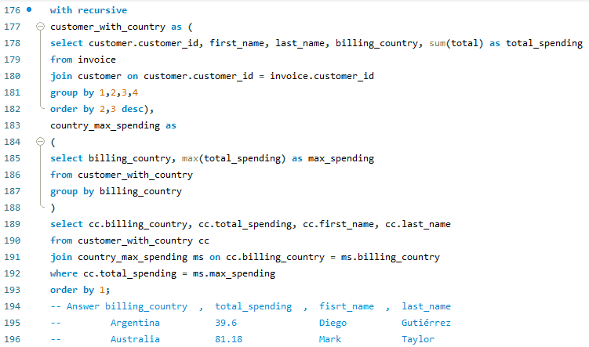
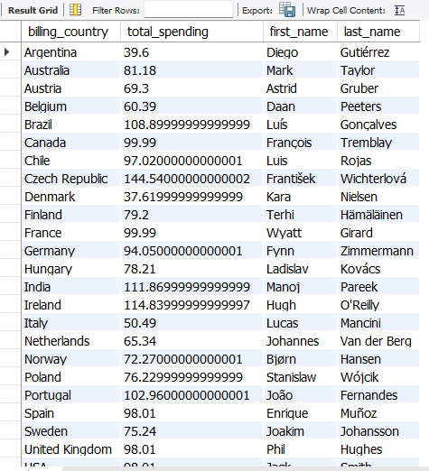
﻿Q11) Write a query that determines the customer that has spent the most on music for each country. -- Write a query that returns the country along with the top customer and how much they spent. -- For countries where the top amount spent is shared, provide all customers who spent this amount

Slide 17
THANK YOU

